Slide 1
NYC JavaScript Meetup
Feb. 22 2017
Greg Solak
Flywheel Sports Engineer

Slide 2
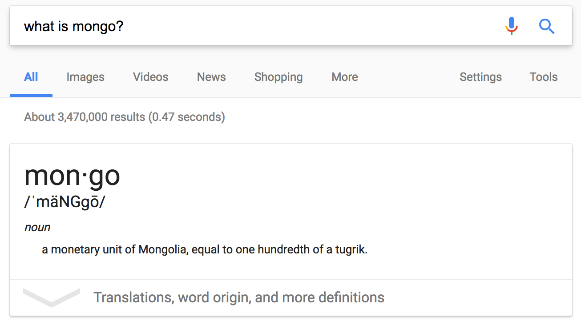
Notes:
Interesting fact –
[picture] – of a google search for ”what is mongo?” showing the definition of ”mongo.”
”Mongo” is a monetary unit of Mongolia, equal to one hudnredth of a tugrik

Slide 3
What is MongoDB?
Open sourced + cross platform document-oriented database
No SQL
Notes:
Mongo is a documented oriented database
(aka) NoSql

Slide 4
{
_id: ObjectId(56adf54ae2301a),
title: 'MongoDB Is Awesome',
description: 'Example document',
tags: ['mongodb', 'database', 'NoSQL'],
comments: [
{
user: 'User 1',
message: 'My first comment',
dateCreated: new Date(2017,2,22,5,15)
},
{
user: 'User 2',
message: 'My second comments',
dateCreated: new Date(2011,2,22,8,45)
}
]
}
Notes:
Example of a MongoDB document
Resembles a “json” object
There is no “schema”. NoSQL is free form and documents can be created without any prior migrations or table definitions.
_id is the “id” of the document. This is a special type of id that we will talk more later (slide #11)
Modified example taken from:
https://www.tutorialspoint.com/mongodb/mongodb_overview.htm

Slide 5
Architecture

Slide 6
Notes:
Top level architecture of mongo:
Split into:
Databases
Collections
Documents

Slide 7
Notes:
Example architecture using a social network as an example.

Slide 8
Notes:
Diagram showing the mongo architecture mapped to a classical sql architecture
[map] – rectangle concepts linking between mongo and sql
SQL → MongoDB
Database → database
Tables → collections
Rows → documents (bson)
Columns → fields

Slide 9
Document
Revisited

Slide 10
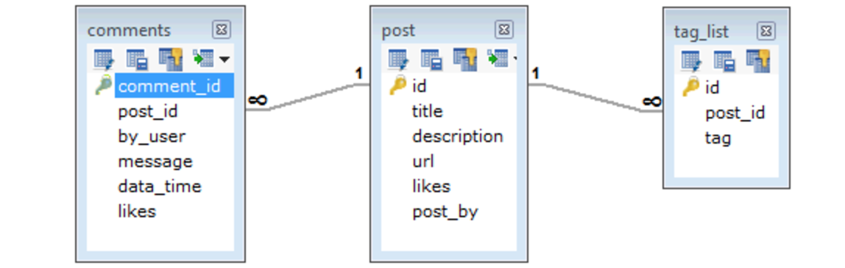
{
_id: ObjectId(56adf54ae2301a),
title: 'MongoDB Is Awesome',
description: 'Example document',
tags: ['mongodb', 'database', 'NoSQL'],
comments: [{…}]
}
Notes:
MongoDB offers a distinct advantage of SQL by not requiring extensive table setup. Here is an example showing a simple document linking (comment to post) and (post to tags).
Normalized SQL requires THREE table definitions. Mongo requires only one document.
Modified example and picture credit:
https://www.tutorialspoint.com/mongodb/mongodb_data_modeling.htm

Slide 11
{
_id: ObjectId(56adf54ae2301a),
title: 'MongoDB Is Awesome',
description: 'Example document',
tags: ['mongodb', 'database', 'NoSQL'],
comments: [
{
...
},
{
_id: ObjectId(57aef23ae5902c),
user: 'User 2',
message: 'My second comments',
dateCreated: new Date(2011,2,22,8,45)
}
]
}
“Primary Key”
Array
Document
Timestamp
Notes:
MongoDB document revisted. -
_id is the primary key or id
Arrays and “embedded” documents are natively suppored
Embedded documents are not “joins”. This is de-normalized and duplicated data. If many records reference the same comment – it might be best to split it off to a separate collection – but for simple apps embedded comments directly is perfectly valid.
MongoDB offers a lot of array support – but it is still challenging to properly query arrays. Keep that in mind when deciding when to normalize / de-normalize your documents.

Slide 12
Mongo _id Properties
Almost universally unique
Ability to generate _id before insert
Stores created at timestamp
5850e57e970a4fa9558b4b5e
2016-12-14T06:23:58.000Z
Notes:
The mongo _id is a special and very powerful “id”:
”Almost” universally unique – should almost always be unique in your own architecture
The id can be generated before an insert – allowing you to reference a mongo ids in mysql directly.
The mongo id can be reversed engineered to find the created_at timestamp. This special property:
removes the need to store “created_at” timestamp,
Used to find all documents created AFTER/BEFORE a specific time, and,
Offers native support for data merges

Slide 13
Use Cases
Simplicity → Quick prototyping → MVP
Large docs → webcrawler
Fast inserts → logging / analytics
No schema → schema likely to change
Database merges natively supported

Slide 14

“With Great Power Comes
Great Responsibility”
Notes:
While Mongo is an extremely powerful database – it is not a “one size fits all” and there are cases in which Mongo is not the best database of choice (see next slide).

Slide 15
Mongo is not Recommended for
Relationships
Atomic transactions → limited support
Strong data integrity → lack of normalization
Cascading deletes / updates → no FK support
Notes:
Mongo can store relationship data but critical relationship should really be stored in a relational database (also known as SQL).

Slide 16
Node JS + MongoDB Demo
Notes:
https://github.com/flywheelsports/NYCJS-at-Flatiron/tree/master/mongodb

